Slide 1

lo siento profe
se nos olvidó hacer la presentación

Slide 2



Wilson-Cowan equations
Zhuo Zhuo Liu
Antonio B. Marín Carballo
Tutor: Rubén Calvo Ibáñez

Slide 3
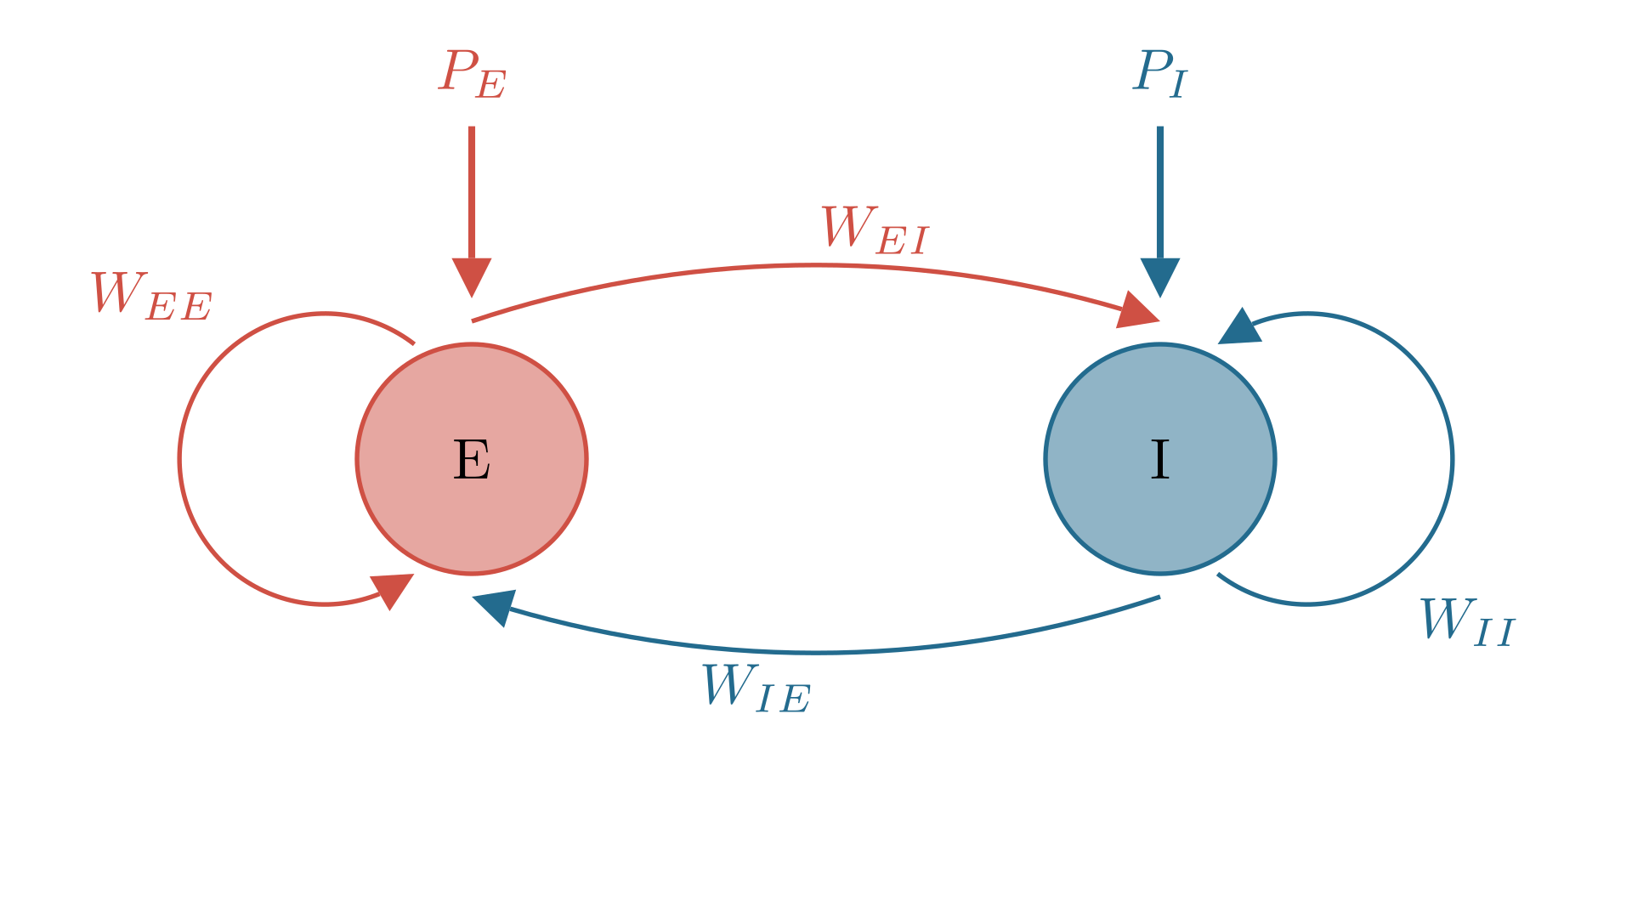
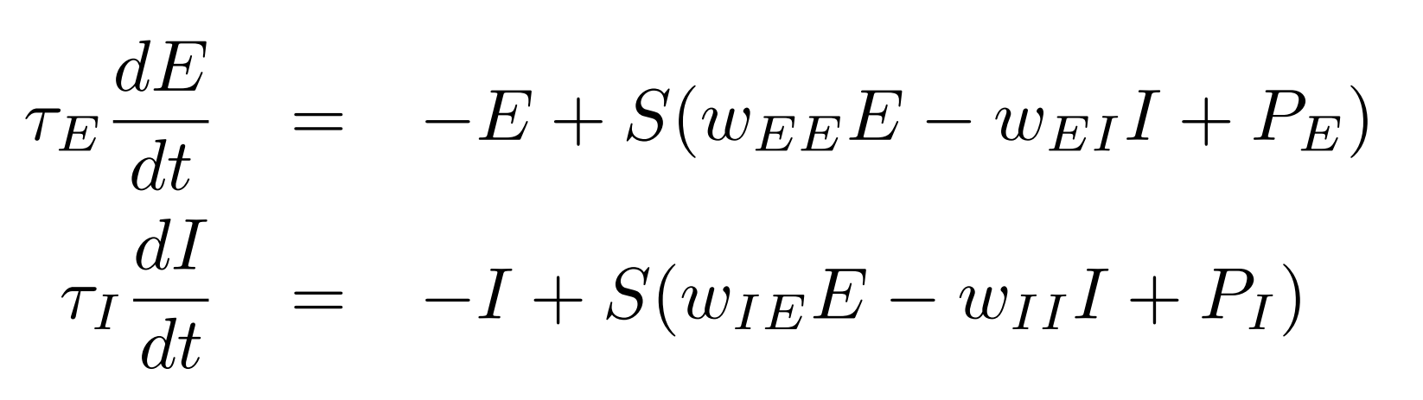
The model

Slide 4
The model
Sigmoid function S(x): Models the behaviour of neurons when receiving input
Time constants:
How quickly the population decays in absence of stimuli
Mean firing rates:
Average number of neurons firing per unit time

Slide 5
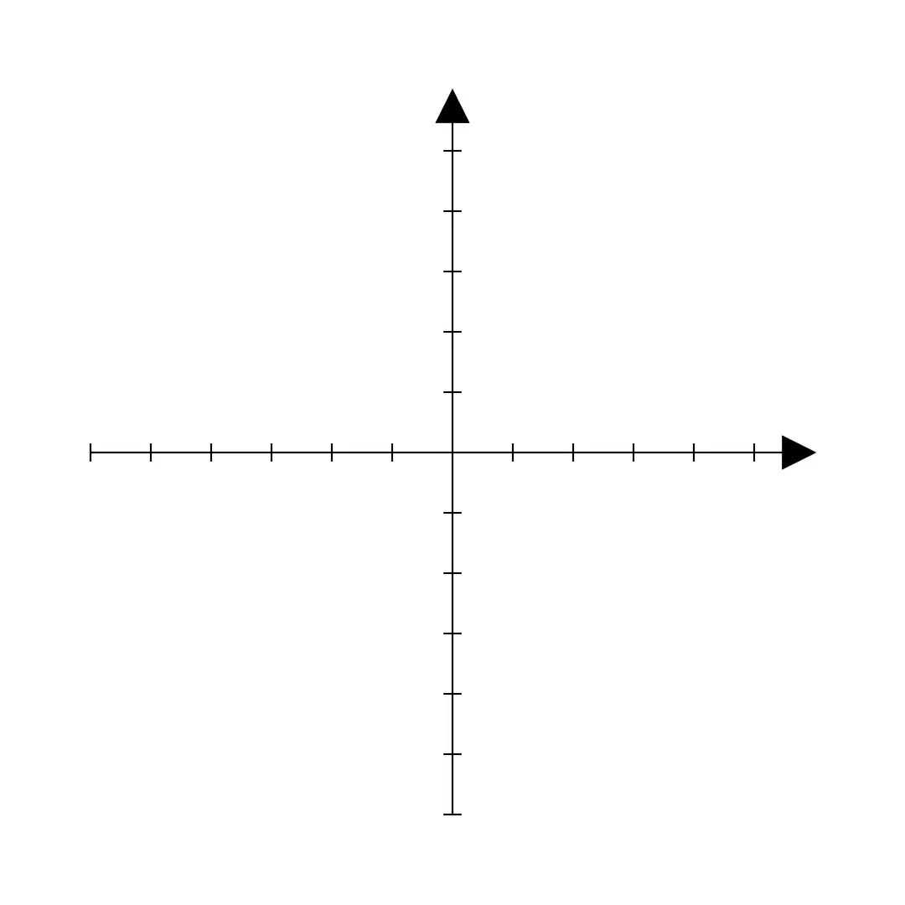
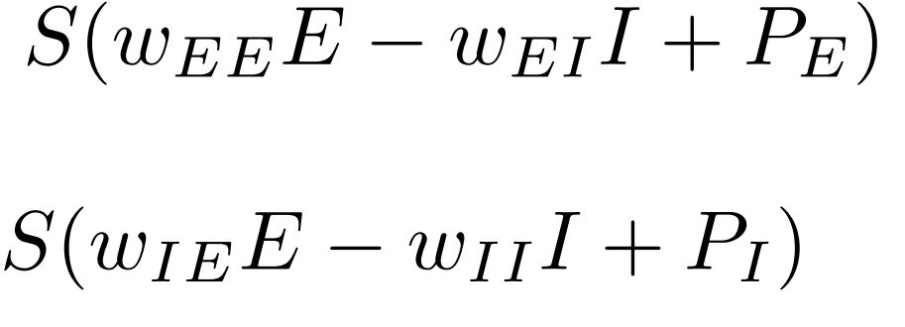
The model: Parameters of the Sigmoid Function
Excitatory input from other E neurons
Inhibition onto E from I neurons.
External input to the excitatory population
Stimuli or modulatory signals from outside the local neural circuit!
External input to the inhibitory population.
Excitation onto I from E neurons
Inhibitory input from other I neurons

Slide 6
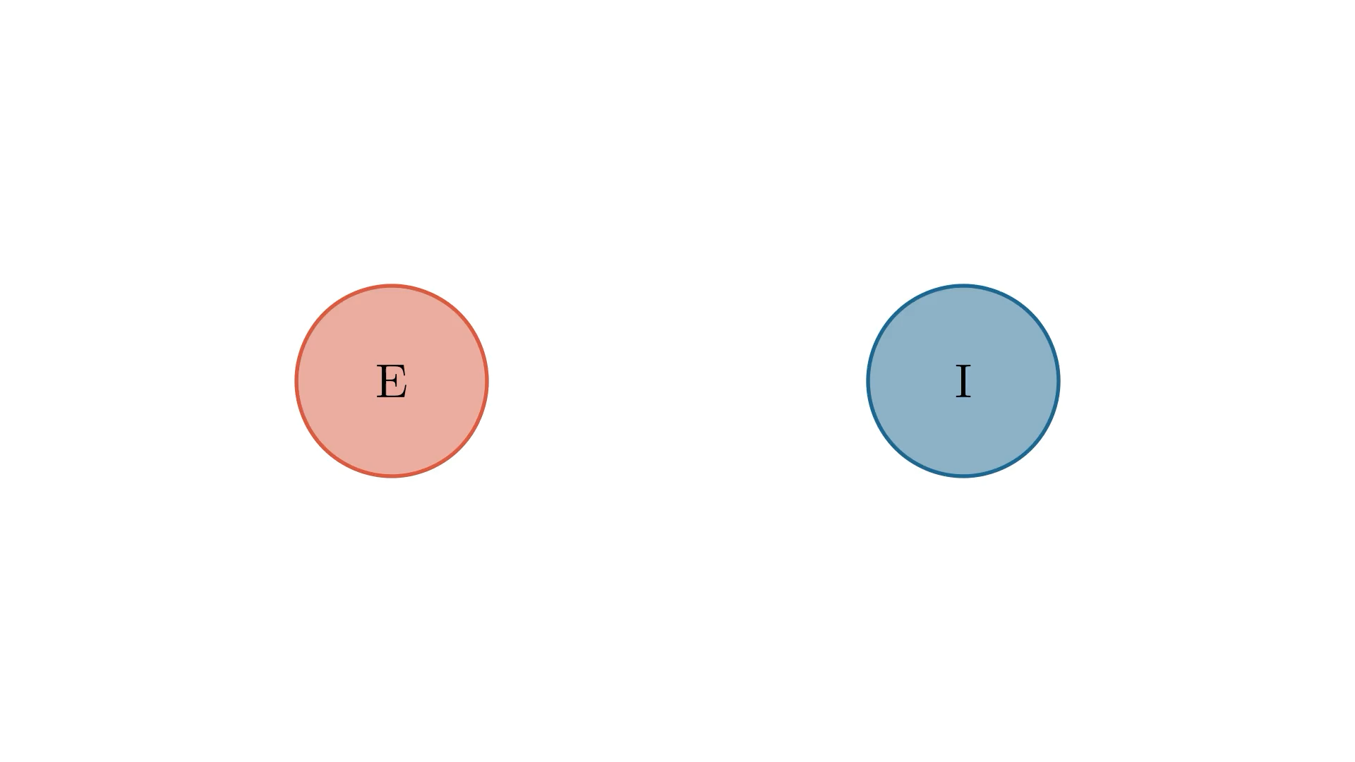
The model

Slide 7
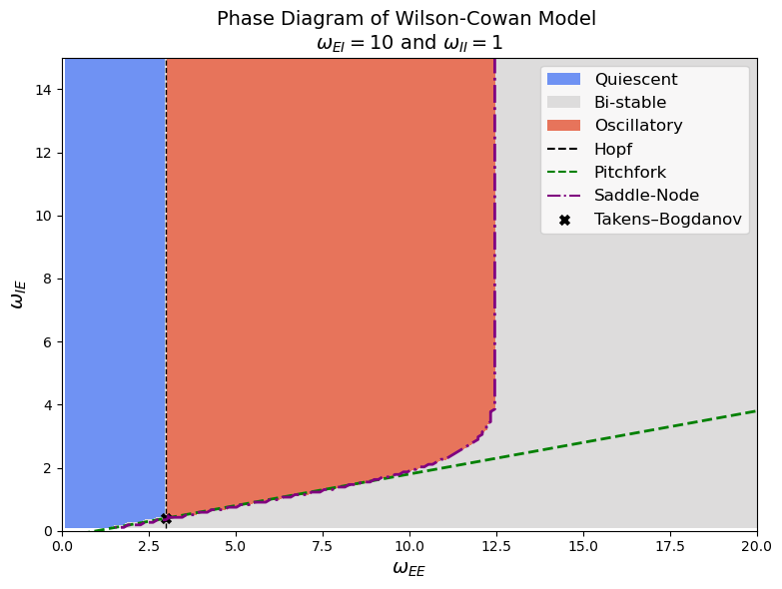
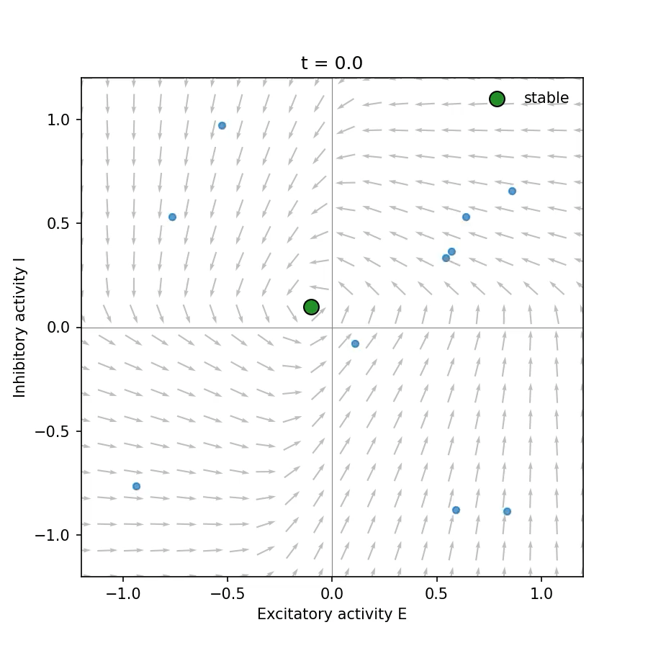
Bifurcations and Dynamical regimes
Quiescent
Stable fixed point
Little to no activity or fluctuations over time.

Slide 8
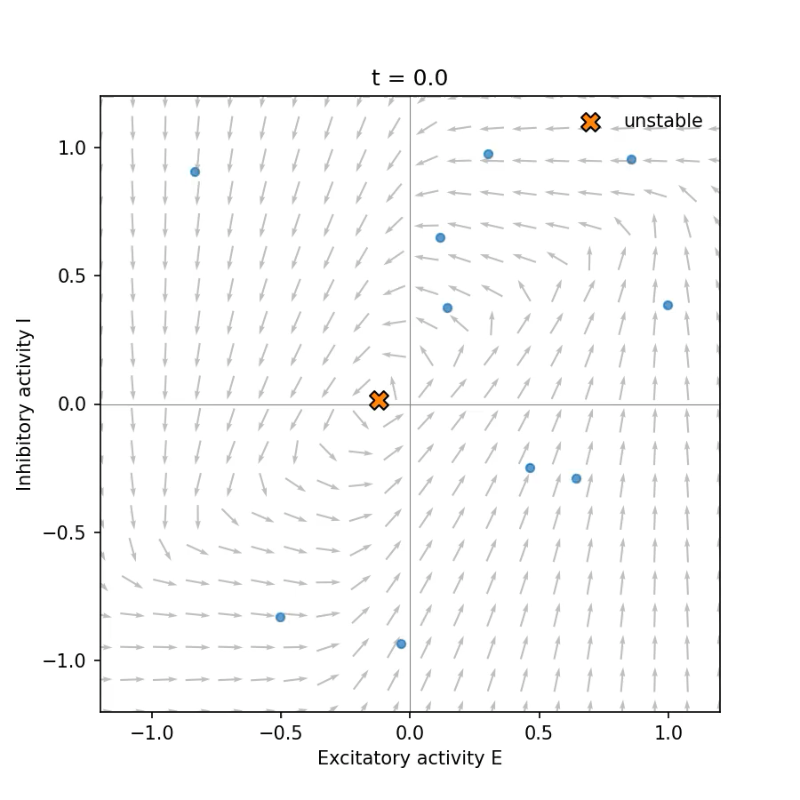
Bifurcations and Dynamical regimes
Oscillatory
Unstable fixed point
System cycles indefinitely through dynamic states, limit cycle

Slide 9
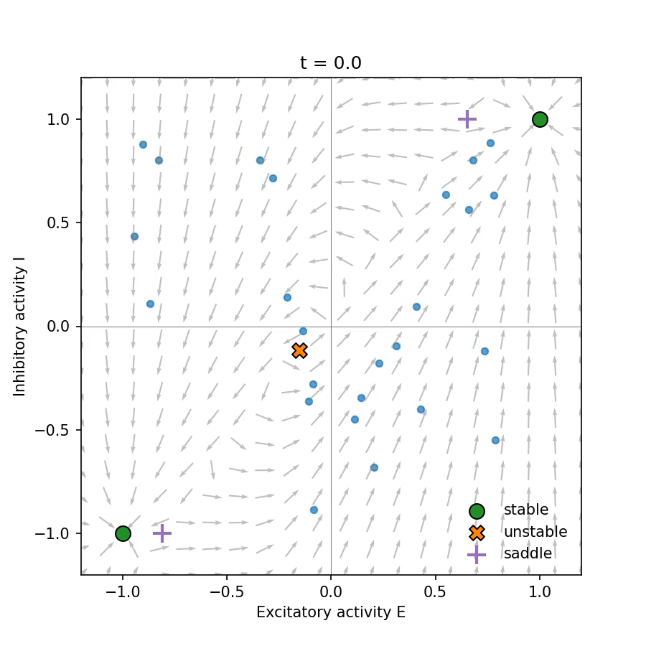
Bifurcations and Dynamical regimes
Bi-stable
2 stable fixed points. 1 unstable fixed point. System settles in one of two states, but a external perturbation can change the state.

Slide 10
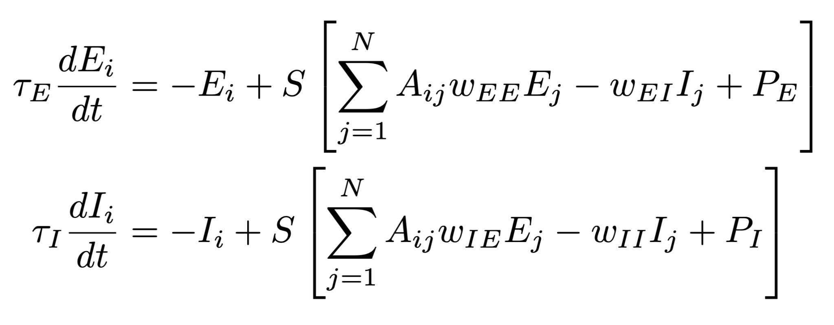
Neural mass modeling
Variables for different brain regions
Component of the adjacency matrix

Slide 11
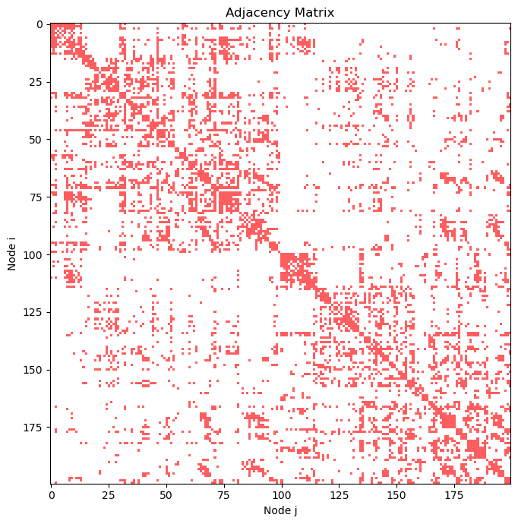
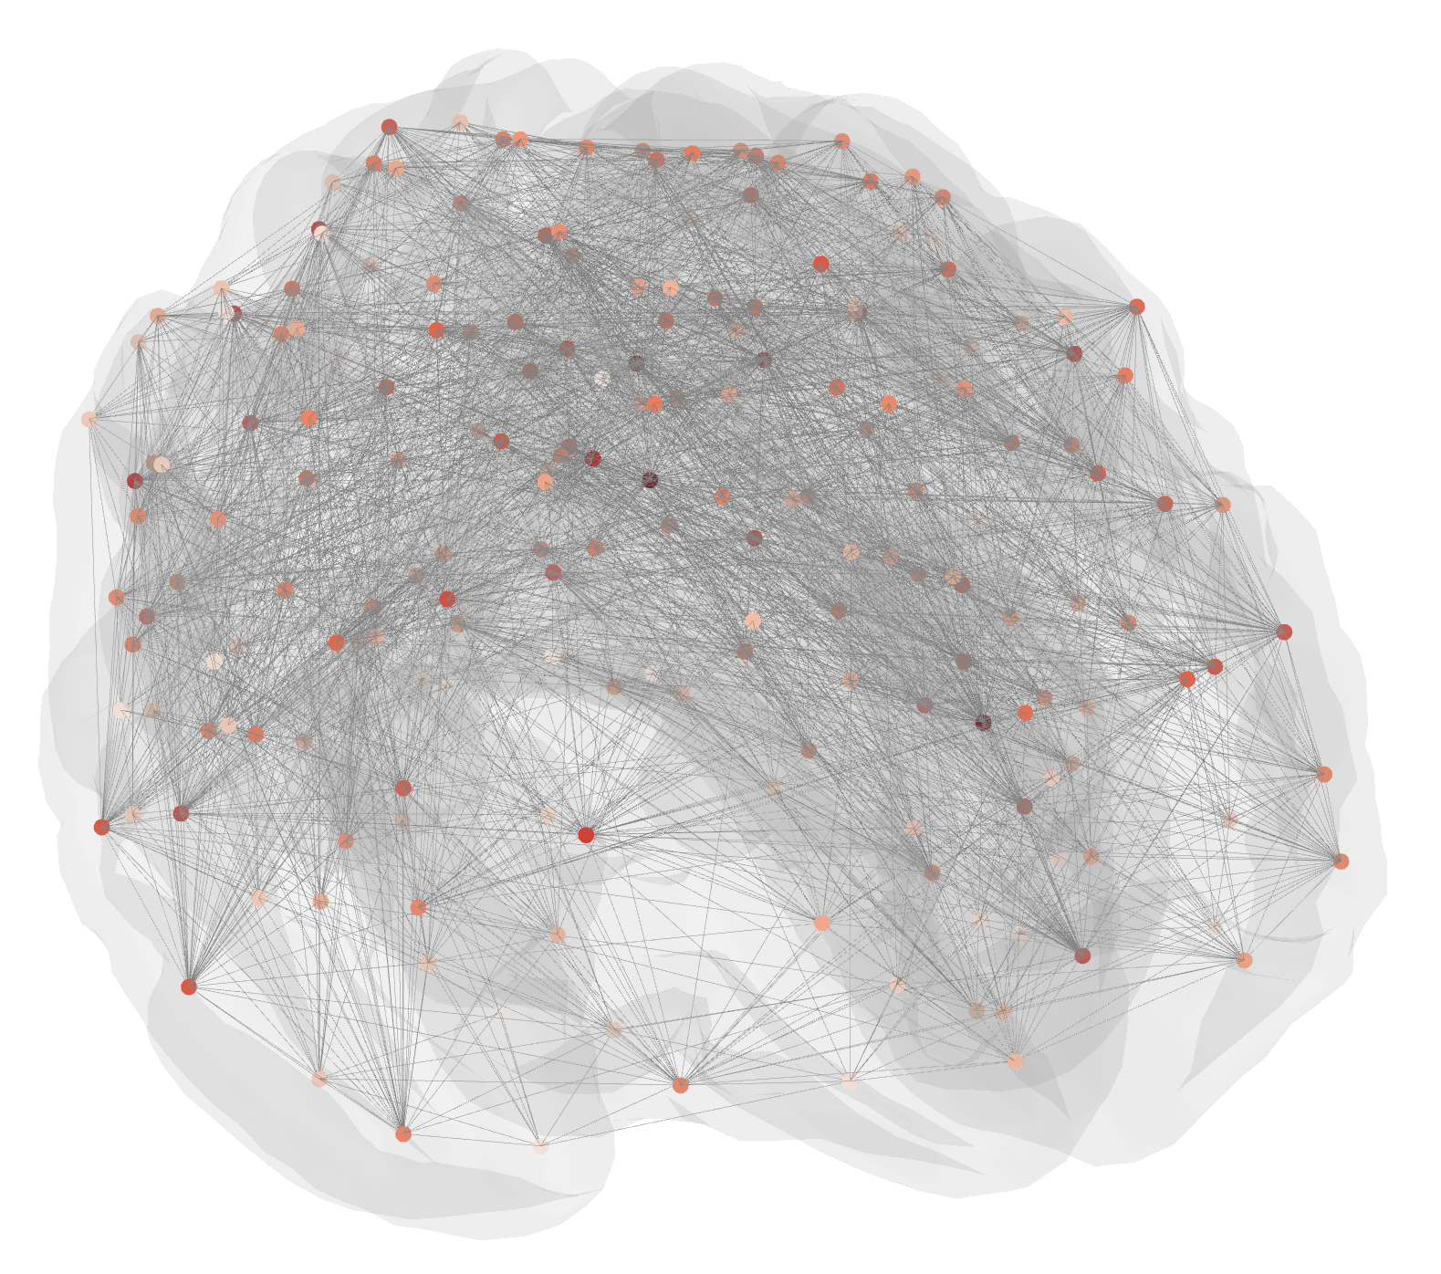
Adjacency matrix
Notes:
HEMISFERIO DERECHO- IZQUIERDO
los que no estan muy llenos son las relaciones entre hemisferios, que son pocas en comparacion con lo autorelacionados que estan los hemisferios con ellos mismos.
laplacian eigenvalues (modulos vibracionales)

Slide 12
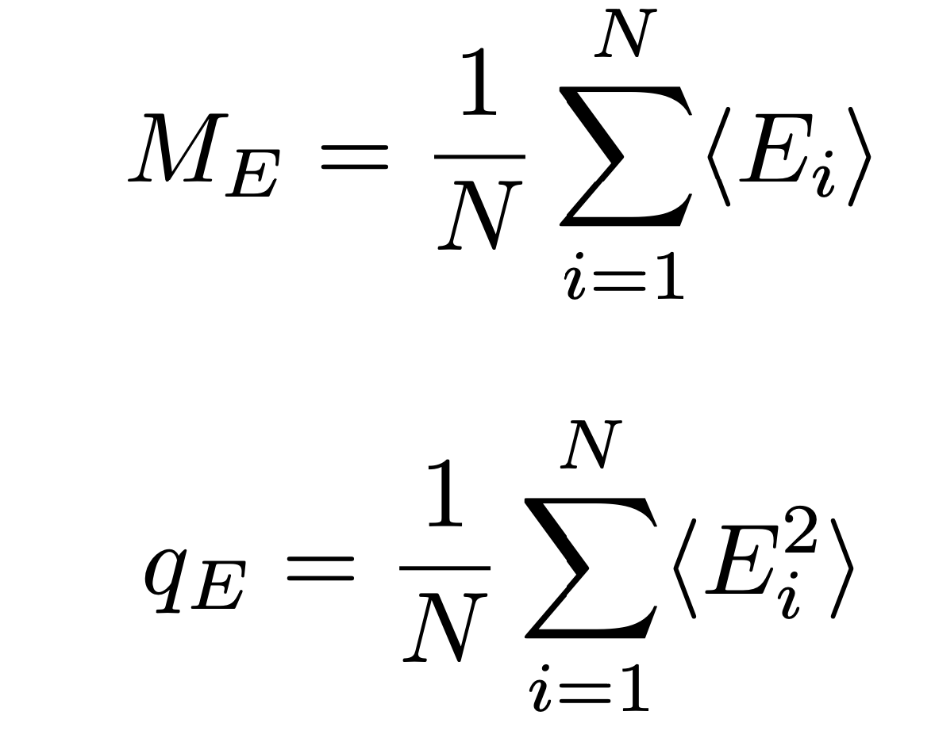
Excitatory activity
Average mean excitatory activity
Average squared excitatory activity

Slide 13
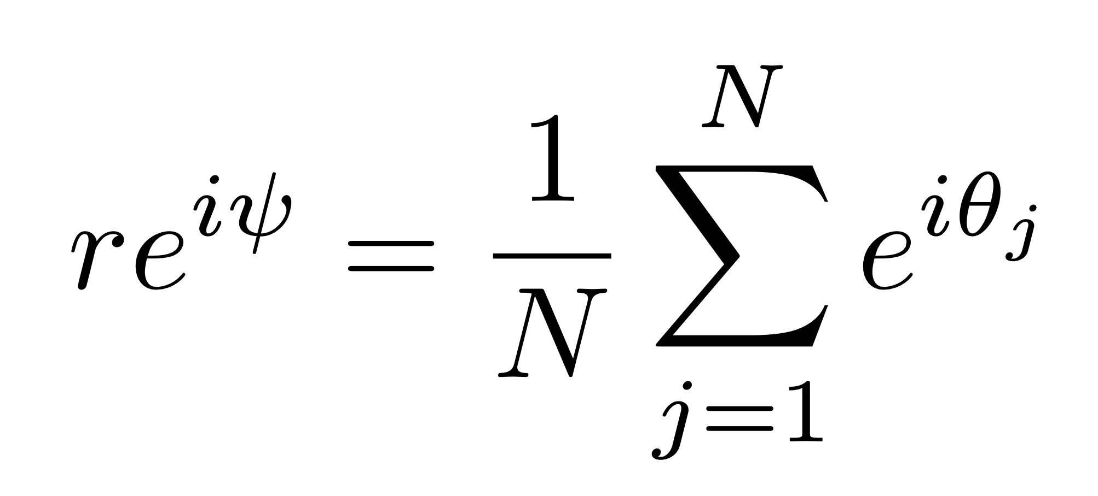
Kuramoto order Parameter: Correlation
Kuramoto order parameter: measure the synchronization for a set of oscillators
Phase of each oscillator
the phase of each oscillator was calculated using the Hilbert transformation.

Slide 14
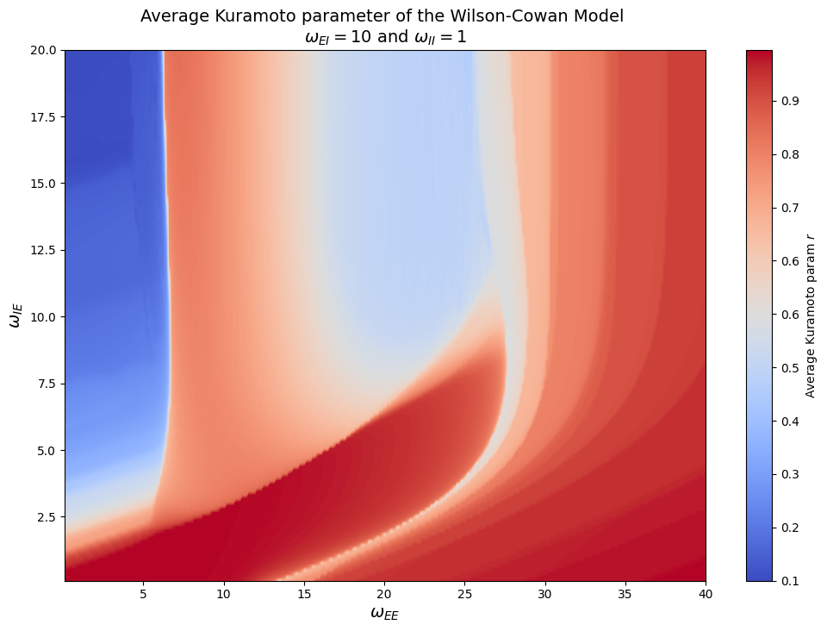
Dynamical regimes in the brain
Quiescent
Oscillatory
Bistable

Slide 15
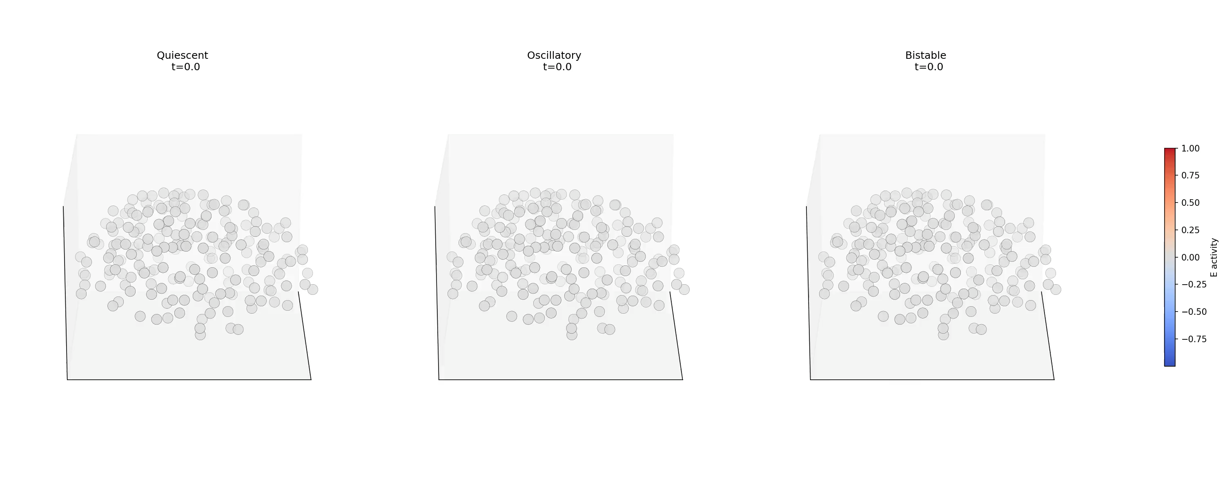
Dynamical regimes in the brain

Slide 16
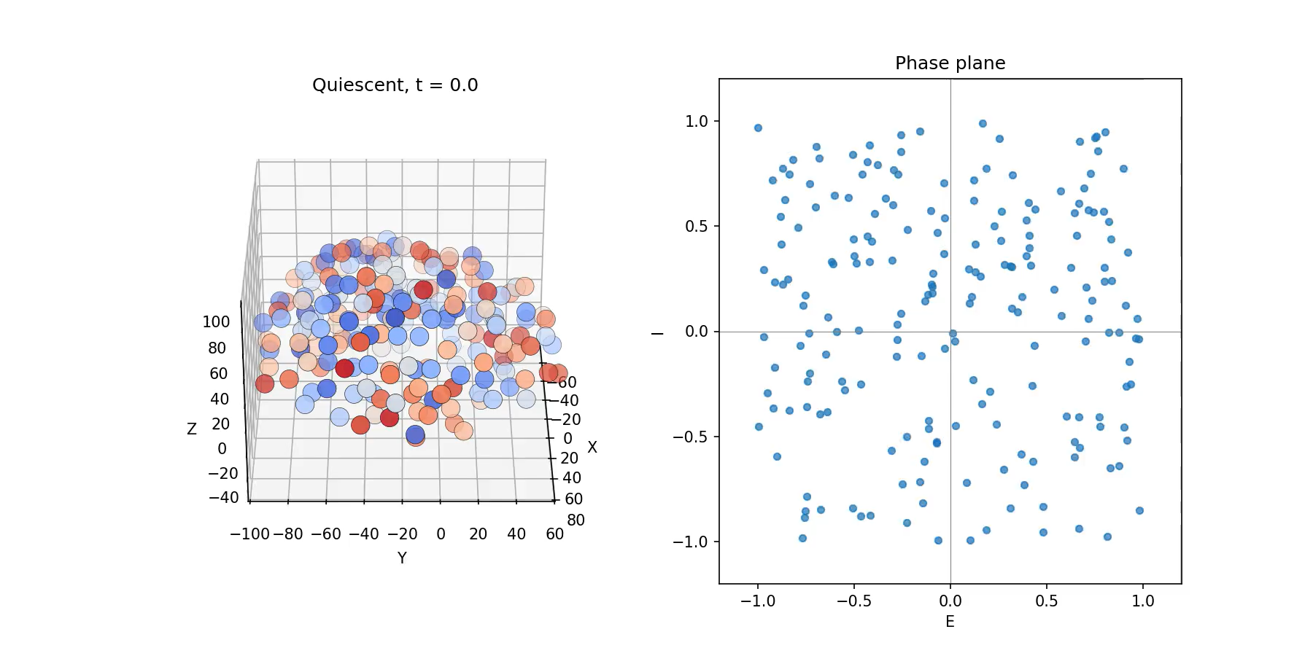
Quiescent

Slide 17
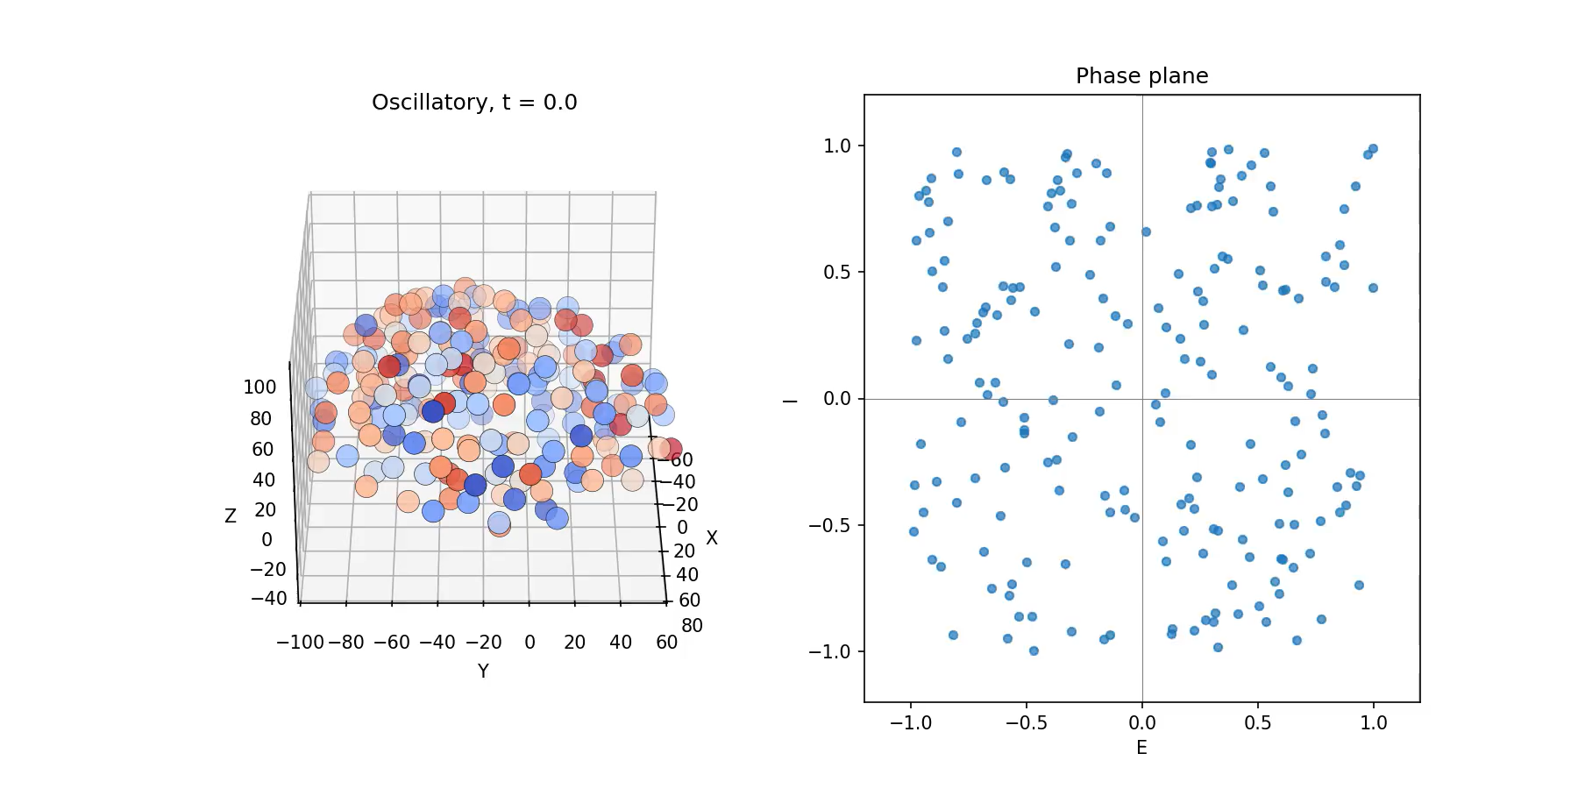
Oscillatory

Slide 18
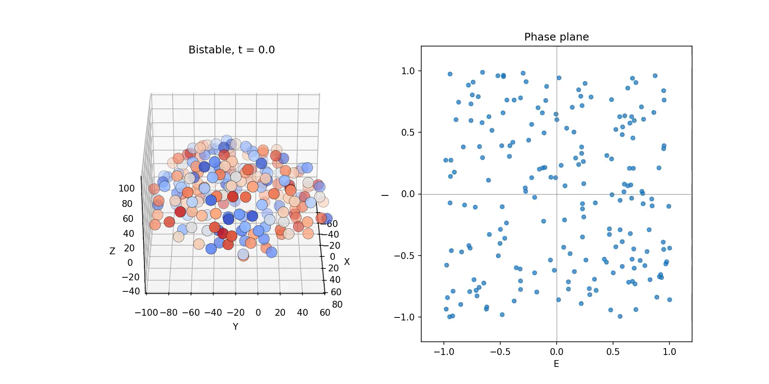
Bi-stable

Slide 19
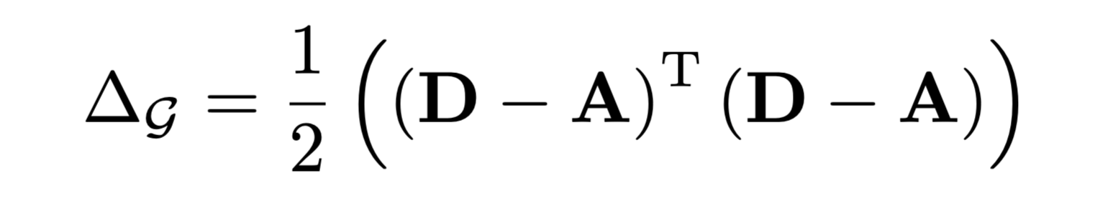
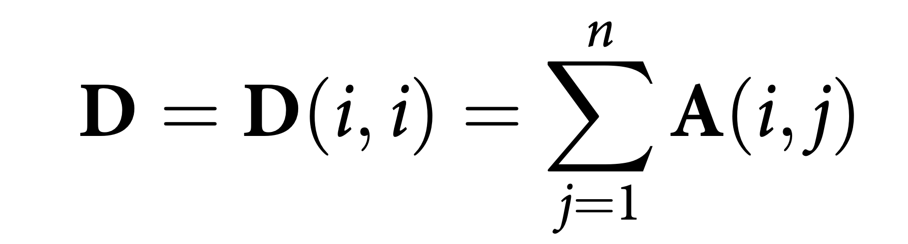
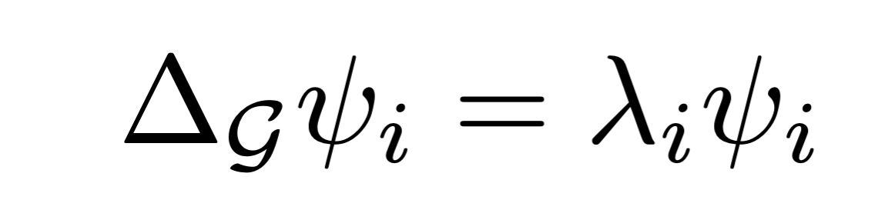
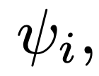
Connectome Laplacian
Given the graph representation of the human connectome, the connectome Laplacian
where D is the degree matrix,
Solving the eigenvalue problem
connectome harmonics

Slide 20
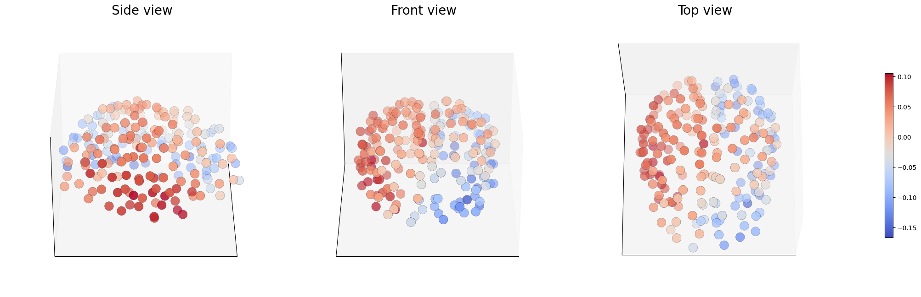
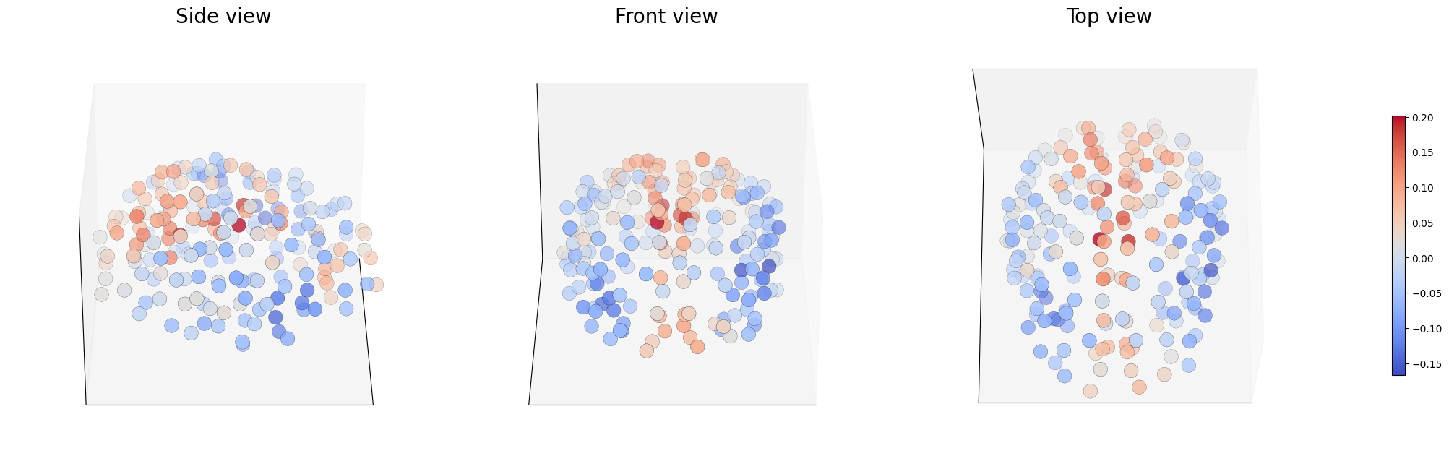
Connectome harmonics
Mode 1
Mode 2

Slide 21
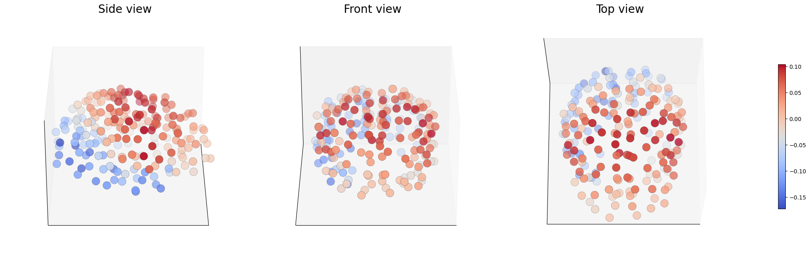
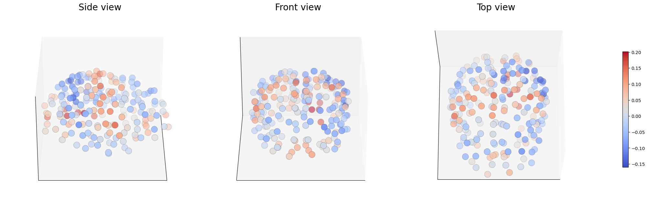
Connectome harmonics
Mode 3
Mode 7

Slide 22

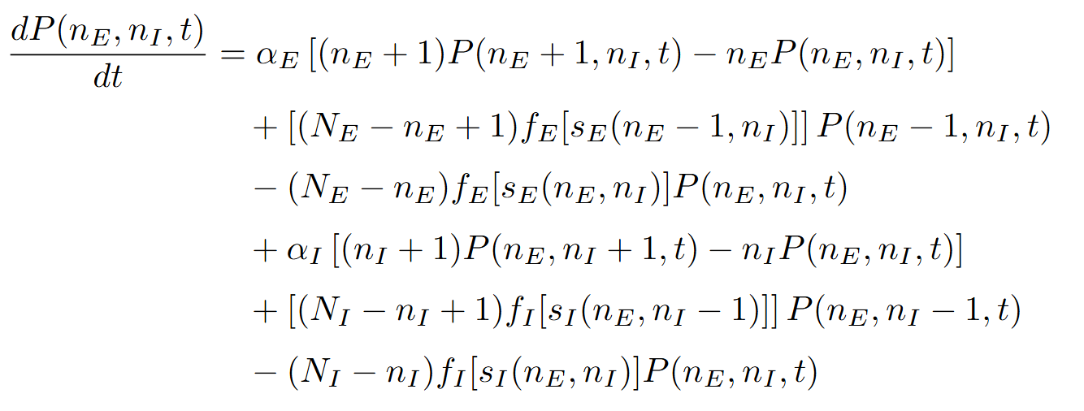
Stochastic brain dynamics
Sounds fun! From microscopic to Fokker-Planck!

Slide 23
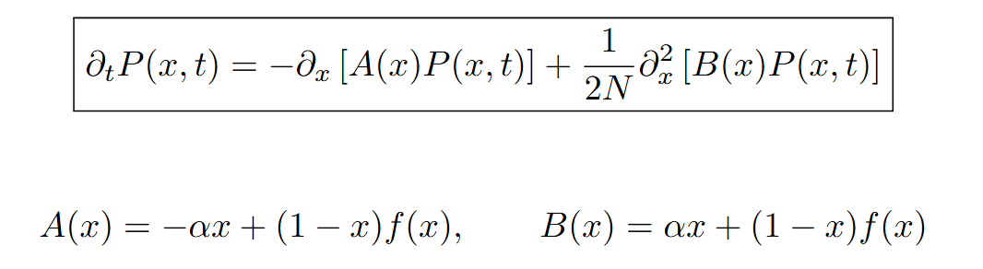
Stochastic brain dynamics
We recover the Wilson-Cowan equations.

Slide 24

The end
Questions?

